Slide 1
JAVA Generics

Slide 2
Generic programming: introduction
Java Generics is a language feature that enables the definition of classes and methods that are implemented independently of some type that they use as an abstraction by accepting a type parameter.
Generic types are instantiated to form parameterized types by providing actual type arguments that replace the formal type parameters.
For example, a class like LinkedList<T> is a generic type, that has a type parameter T. Instantiations, such as LinkedList<String> or a LinkedList<Integer>, are called parameterized types, and String and Integer are the respective actual type arguments.

Slide 3
Java generics: implementation
The Java compiler uses a technique called type erasure to translate generic classes into executable code.
Type erasure eliminates all generic type information at compile time.
All the type information between angle brackets is thrown out so, for example, a parameterized type like List<String> is converted into a List raw type.
All remaining uses of type variables are replaced by the upper bound of the type variable (or Object if there is no type bound).
Whenever the resulting code isn’t type-correct, a cast to the appropriate type is automatically inserted.

Slide 4
Erasure and Translation
public String loophole(Integer x) {
List<String> ys = new LinkedList<String>();
List xs = ys;
xs.add(x); // compile-time unchecked warning
return ys.iterator().next();
}
Here, we’ve aliased a list of strings and a plain old list. We insert an Integer into the list, and attempt to extract a String. This is clearly wrong. If we ignore the warning and try to execute this code, it will fail exactly at the point where we try to use the wrong type. At run time, this code behaves like:
public String loophole(Integer x) {
List ys = new LinkedList;
List xs = ys;
xs.add(x);
return (String) ys.iterator().next(); // run time error
}
When we extract an element from the list, and attempt to treat it as a string by casting it to String, we will get a ClassCastException. The exact same thing happens with the generic version of loophole().
The reason for this is, that generics are implemented by the Java compiler as a front-end conversion called erasure. You can (almost) think of it as a source-to-source translation, whereby the generic version of loophole() is converted to the non-generic version. As a result, the type safety and integrity of the Java virtual machine are never at risk, even in the presence of unchecked warnings.
Basically, erasure gets rid of (or erases) all generic type information. All the type information between angle brackets is thrown out, so, for example, a parameterized type like List<String> is converted into List. All remaining uses of type variables are replaced by the upper bound of the type variable (usually Object). And, whenever the resulting code isn’t type-correct, a cast to the appropriate type is inserted, as in the last line of loophole.

Slide 5
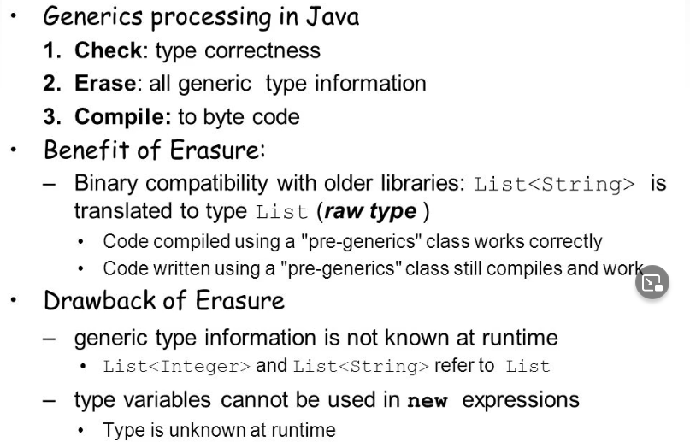
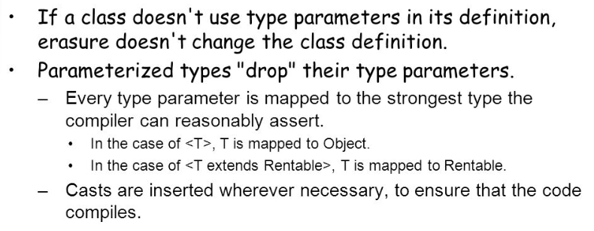
Erasure and Translation
K

Slide 6
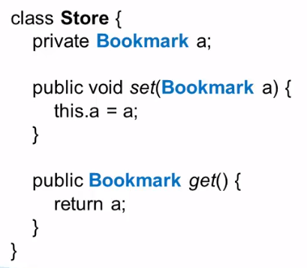
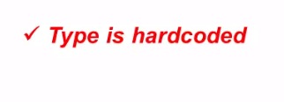
Store object can hold only Bookmark instance or one of it's subtype instance.

Slide 7
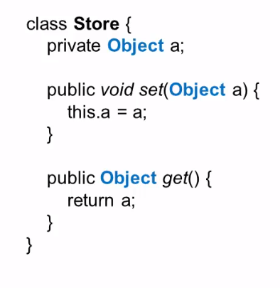
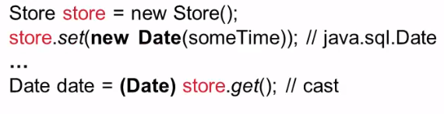






What issues we can face here ?
This kind of issues we can encounter when we use object as a polymorphic type.
To resolve all these issues and avoid run time exceptions designers implemented Generics to check issues during compile time itself
Type safety check is done during runtime.

Slide 8
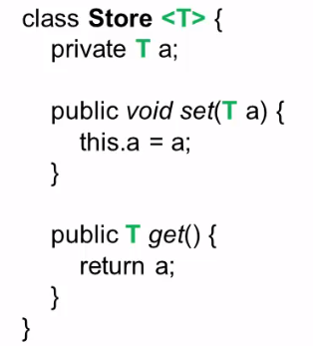
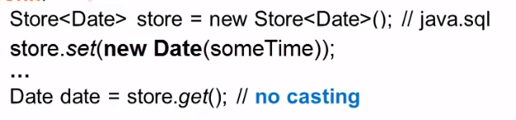
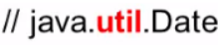

Generics
Type parameter
Since we are now using Generics there is no scope for runtime exceptions, provides type safety during compile time itself.
Generics implemented in Java 5 to reduce compile time issues and ensure type safety at compile time itself.

Slide 9

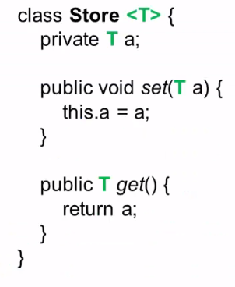
Generic Type
Example:

Slide 10
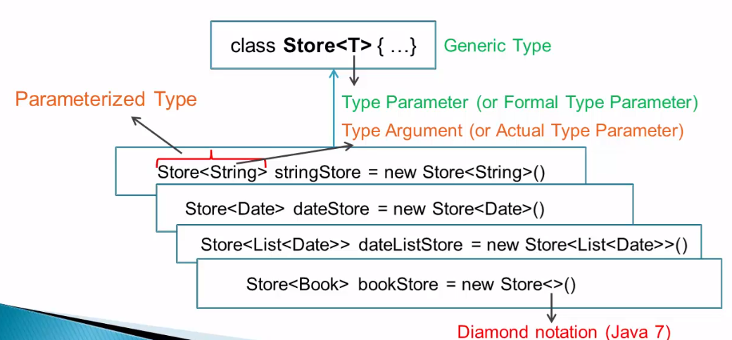
Generic Type & Parameterized Type

Slide 11
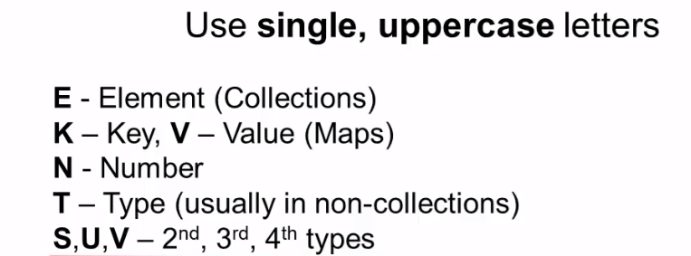
Type Parameter Naming Conventions

Slide 12
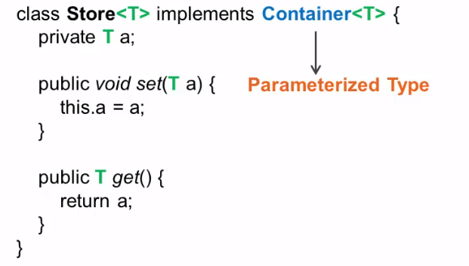
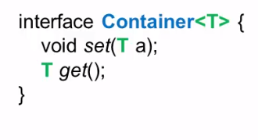
Subtyping of Generic Types

Slide 13
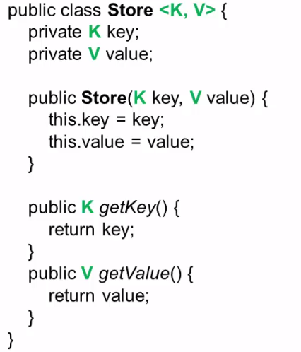
Multiple Type Parameters

Slide 14
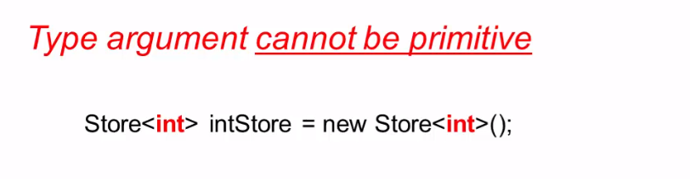
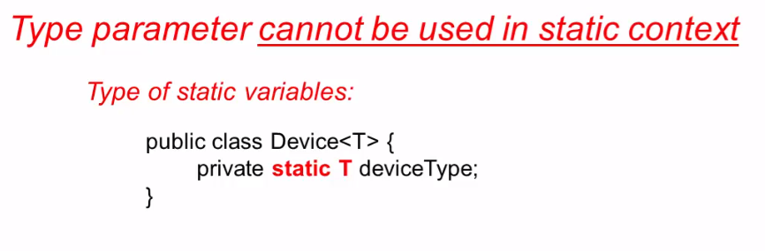
Restrictions

Slide 15
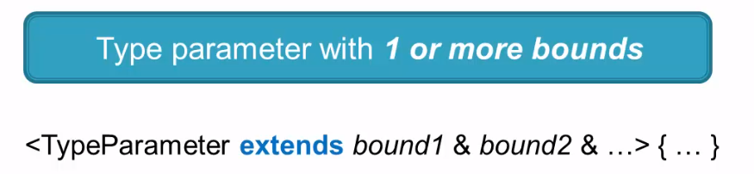

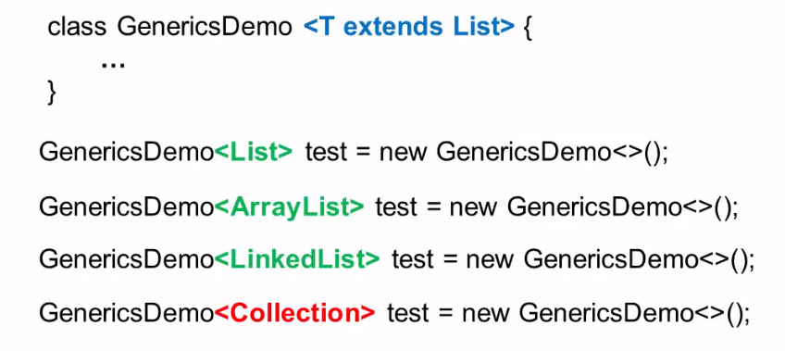
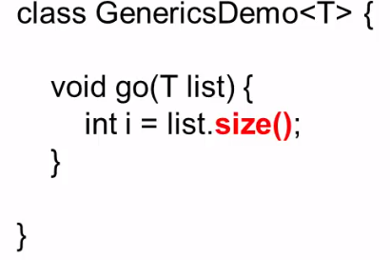
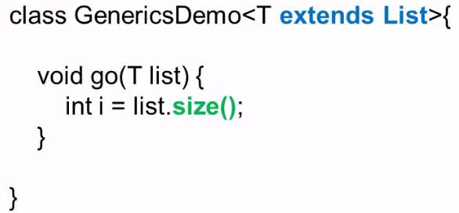
Bounded Type Parameter
Example:

Slide 16
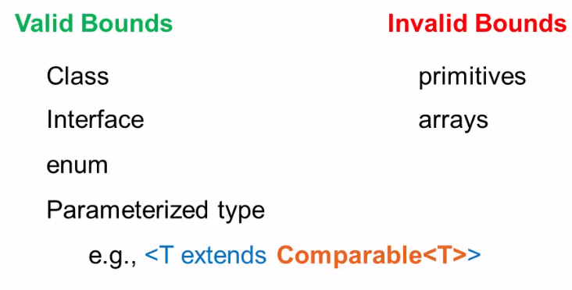
Bounded Type Parameter

Slide 17
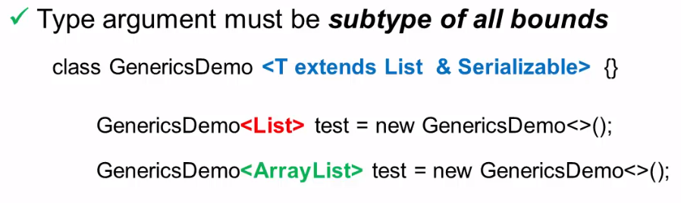
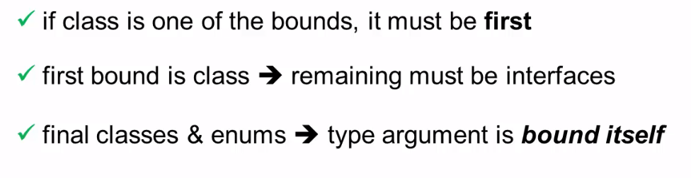
Specifics

Slide 18
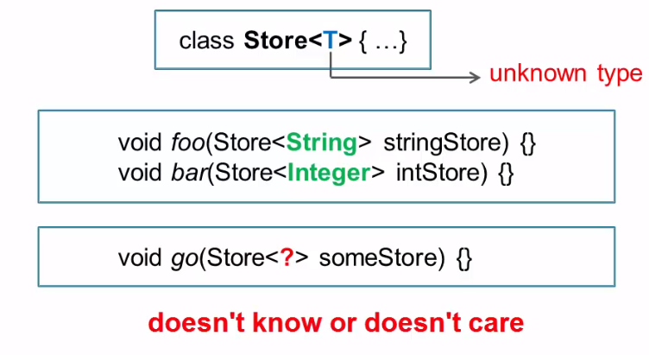
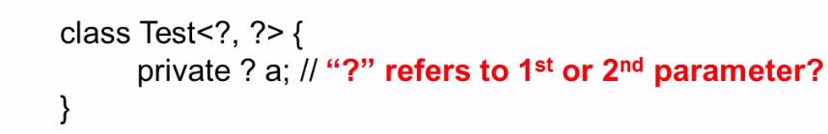
WildCard
Wildcard can be used only as type argument, it cannot be used as type parameter
Parameterized type is generified here

Slide 19
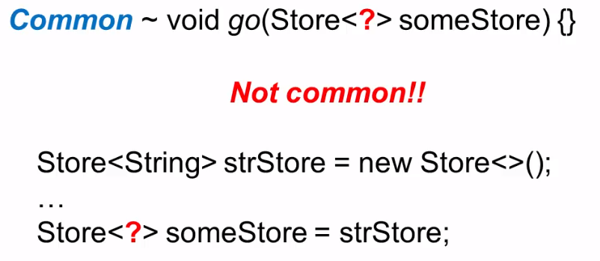
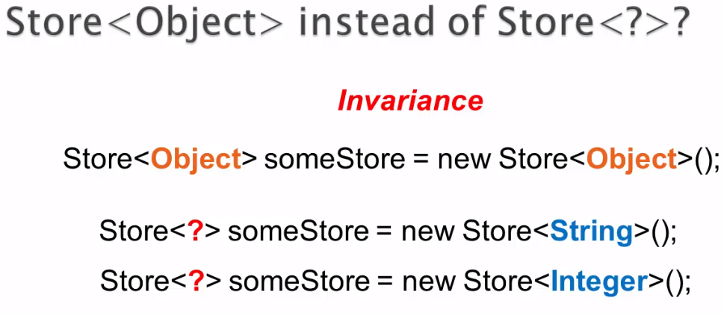
Common Usage

Slide 20
Java Generics: wildcards
A wildcard is a syntactic construct that is used to denote a family of types in a generic class/method instantiation. There are three different kinds of wildcards:
" ? " : the unbounded wildcard. It stands for the family of all types.
" ? extends SuperType " : a wildcard with an upper bound. It stands for the family of all types that are SuperType itself or subtypes of SuperType.
" ? super SubType " - a wildcard with a lower bound. It stands for the family of all types that are SubType itself or supertypes of SubType.
? extends T represents an upper bounded wildcard. The unknown type represents a type that must be a subtype of T, or type T itself.
? super T represents a lower bounded wildcard. The unknown type represents a type that must be a supertype of T, or type T itself.

Slide 21
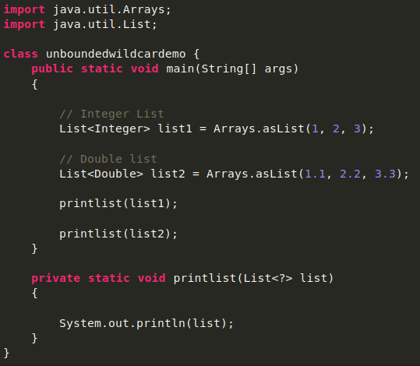
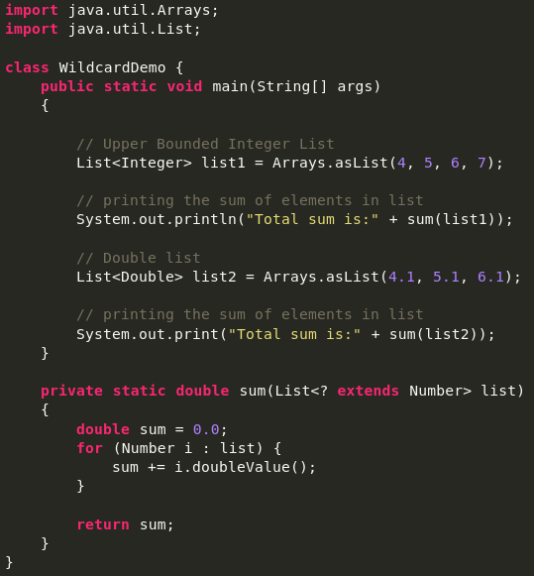
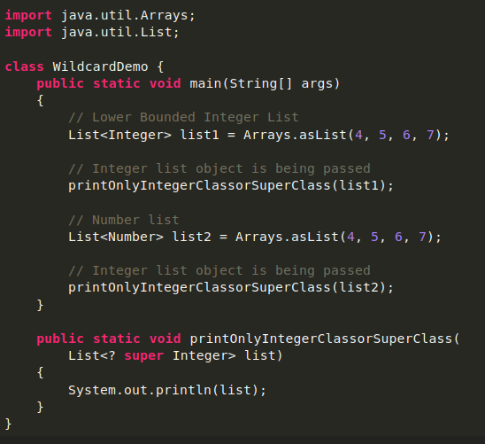
Unbounded Wildcard
Upper Bounded Wildcards
Lower Bounded Wildcards
This wildcard type is specified using the wildcard character (?), for example, List. This is called a list of unknown types. These are useful in the following cases –
When writing a method that can be employed using functionality provided in Object class.
When the code is using methods in the generic class that doesn’t depend on the type parameter
These wildcards can be used when you want to relax the restrictions on a variable. For example, say you want to write a method that works on List < Integer >, List < Double >, and List < Number >, you can do this using an upper bounded wildcard.

Slide 22
What is the difference between using <T> and a wildcard <?> in Java Generics?
There are certain places, where wildcards, and type parameters do the same thing. But there are also certain places, where you have to use type parameters.
If you want to enforce some relationship on the different types of method arguments, you can't do that with wildcards, you have to use type parameters.
suppose you want to ensure that the src and dest list passed to copy() method should be of same parameterized type, you can do it with type parameters like so:
public static <T extends Number> void copy(List<T> dest, List<T> src)
Here, you are ensured that both dest and src have same parameterized type for List. So, it's safe to copy elements from src to dest.
But, if you go on to change the method to use wildcard:
public static void copy(List<? extends Number> dest, List<? extends Number> src)
it won't work as expected. In 2nd case, you can pass List<Integer> and List<Float> as dest and src. So, moving elements from src to dest wouldn't be type safe anymore. If you don't need such kind of relation, then you are free not to use type parameters at all.
Some other difference between using wildcards and type parameters are:
If you have only one parameterized type argument, then you can use wildcard, although type parameter will also work.
Type parameters support multiple bounds, wildcards don't.
Wildcards support both upper and lower bounds, type parameters just support upper bounds. So, if you want to define a method that takes a List of type Integer or it's super class, you can do:
public void print(List<? super Integer> list) // OK
but you can't use type parameter:
public <T super Integer> void print(List<T> list) // Won't compile
<?> means any something like Object can accept any class instance.
<T> means it is of a particular class type, where ever T is used same class type is valid in all places.

Slide 23
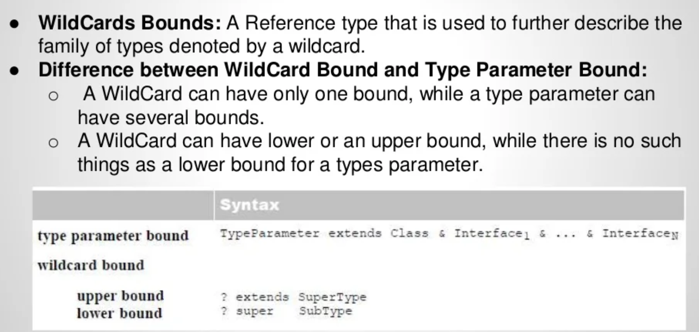
Wildcards in Generics

Slide 24
Java Generics: wildcards
public void printCollection( Collection<?> c ){
for (Object o : c){
System.out.println(o);
}
}
public static <T> void copy( List<? super T> dest, List<? extends T> src) {
for (int i=0; i<src.size(); i++)
dest.set(i,src.get(i));
}
}
The method printCollection() receives a parameter that is a Collection of elements of any type. It can do so because it does not apply any type-specific operation on the Collection it receives as a parameter.
The method copy() receives as parameters two lists, where the type of elements in the source List must be a subtype of type of elements in the destination List. Failure to impose such a restriction may allow to attempt to copy the elements of a list into a list of elements of an unrelated type, leading to an illegal type cast. It must do so because it uses get() and set(), which are bound to the type of values stored in the List.

Slide 25
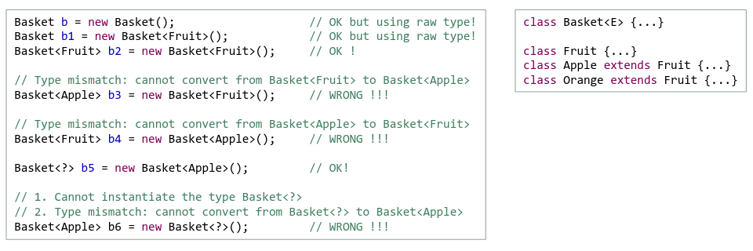
Generic classes: instantiation vs. type parameter
If a generic class is referred to without using any type parameter, it refers to a raw type, i.e. a class that has been subject to type erasure, taking the generic type’s uppermost allowable type as type argument. In the example above, a raw Basket is a Basket of Object.
Wildcards must be used in a context where they can be verified to instantiate to a specific type at runtime, e.g. new Basket<?>() is invalid as it attempts to create a Basket containing a value of unknown type.

Slide 26
Generic classes/methods: definition
A class or method that is defined with a parameter for a type is called a generic class/method or a parameterized class/method
For classes, the type parameter is included in angular brackets after the class name in the class definition heading.
For methods, the type parameter is included before the method definition.
Methods can define/use additional type parameters additional to their class’ type parameters.
The type parameters are to be used like other types used in the definition of a class/method.
When a generic class is used, the specific type to be plugged in is provided in angular brackets.
When a generic method is called, its call’s parameter/return type are plugged in.
/**
* Generic class that defines a wrapper class around a single
* element of a generic type.
*/
public class Box<T extends Number> {
private T t;
public void set(T t) {
this.t = t;
}
public T get() {
return t;
}
/**
* Generic method that uses both the generic type of the class
* it belongs to, as well as an additional generic type that is
* bound to the Number type.
*/
public void inspect(){
System.out.println("T: " + t.getClass().getName());
}
public <U> void inspectWithAdditionalType(U u){
System.out.println("T: " + t.getClass().getName());
System.out.println("U: " + u.getClass().getName());
}
public static void main(String[] args) {
Box<Integer> integerBox = new Box<Integer>();
integerBox.set(new Integer(10));
integerBox.inspect();
integerBox.inspectWithAdditionalType("Hello world");
Integer i = integerBox.get();
}
}

Slide 27
Generic classes/methods: type erasure
/**
* Generic class that defines a wrapper class around a single
* element of a generic type.
*/
public class Box {
private Number t;
public void set(Number t) {
this.t = t;
}
public Number get() {
return t;
}
/**
* Generic method that uses both the generic type of the class
* it belongs to, as well as an additional generic type that is
* bound to the Number type.
*
*/
public void inspect(){
System.out.println("T: " + t.getClass().getName());
}
public void inspectWithAdditionalType(Object u){
System.out.println("T: " + t.getClass().getName());
System.out.println("U: " + u.getClass().getName());
}
public static void main(String[] args) {
Box integerBox = new Box();
integerBox.set(new Integer(10));
integerBox.inspect();
integerBox.inspectWithAdditionalType("Hello world");
Integer i = integerBox.get();
}
}
When the class is compiled, type erasure is applied on the type parameter for each specific use of the generic class or method:
Every occurrence of the type parameter is replaced with the highest type applicable to the type parameter.
If a type bound was specified, this type is applied. If no type bound was specified, Object is used.
If a value is extracted from a generic class or returned from a generic method that is of the type parameter type, its type is automatically casted to the type used at instantiation.

Slide 28
Thank you

Slide 29
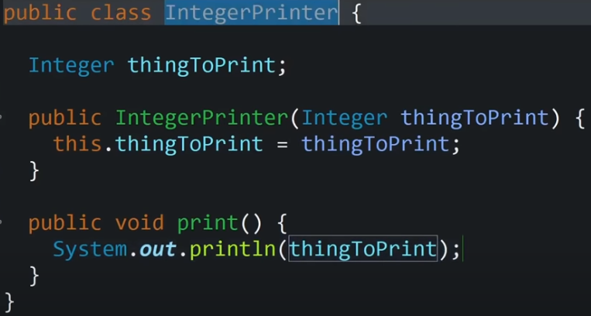
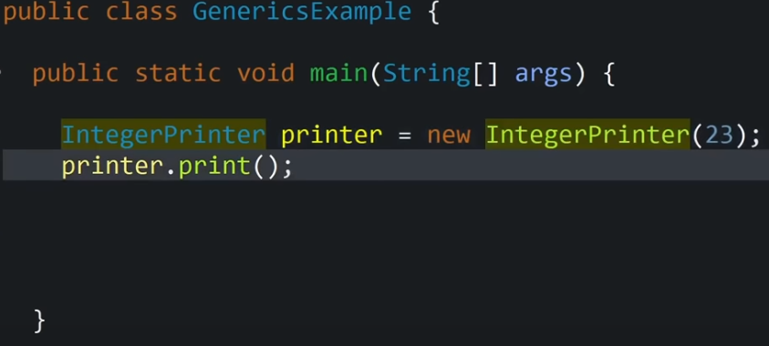
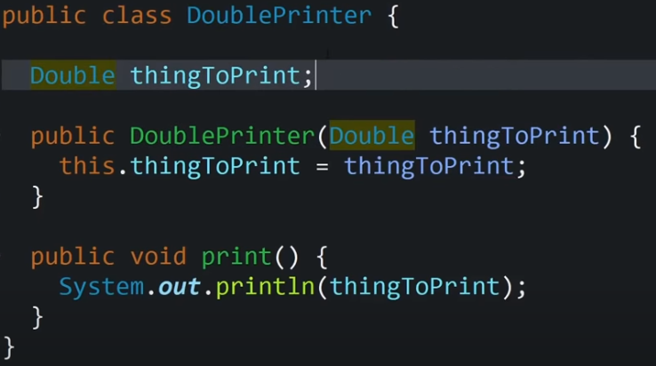
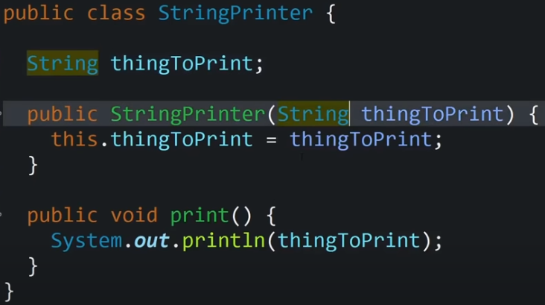
Generic Examples

Slide 30
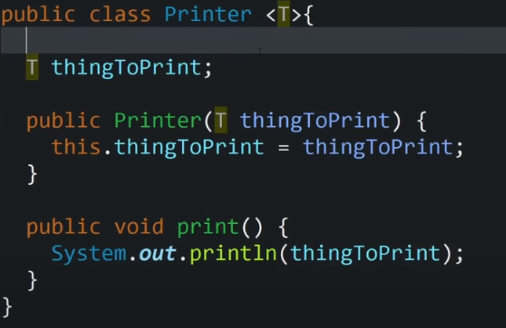
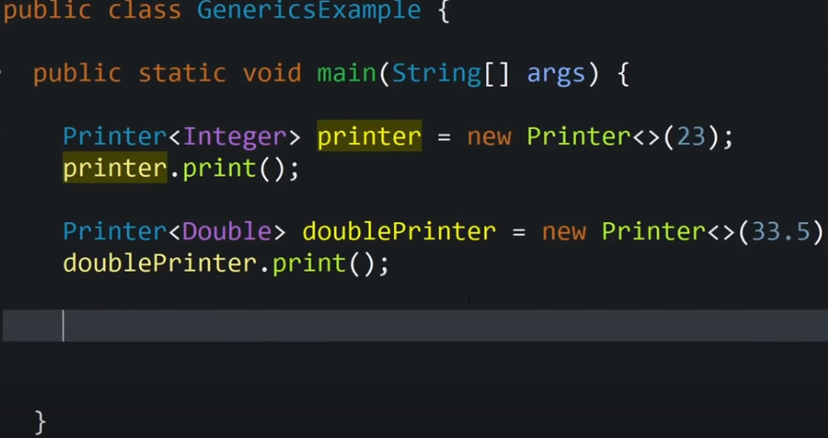
Generic Printer Class
Type parameter
T represents type of thing printer can able to hold and print
This gives ability to create printers for any types.

Slide 31
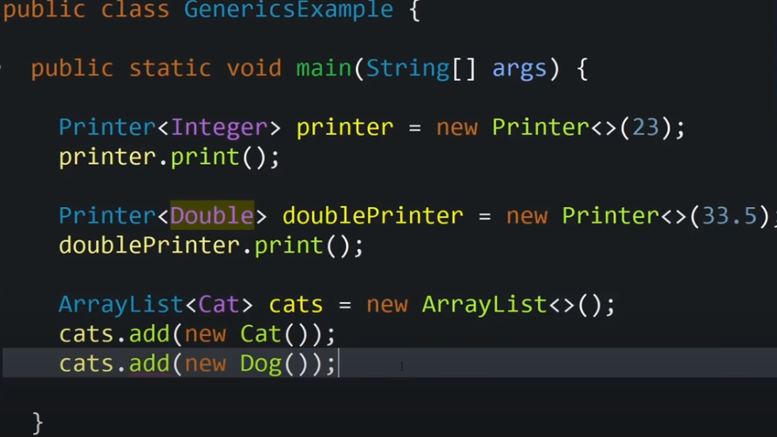
Compilation Error

Slide 32
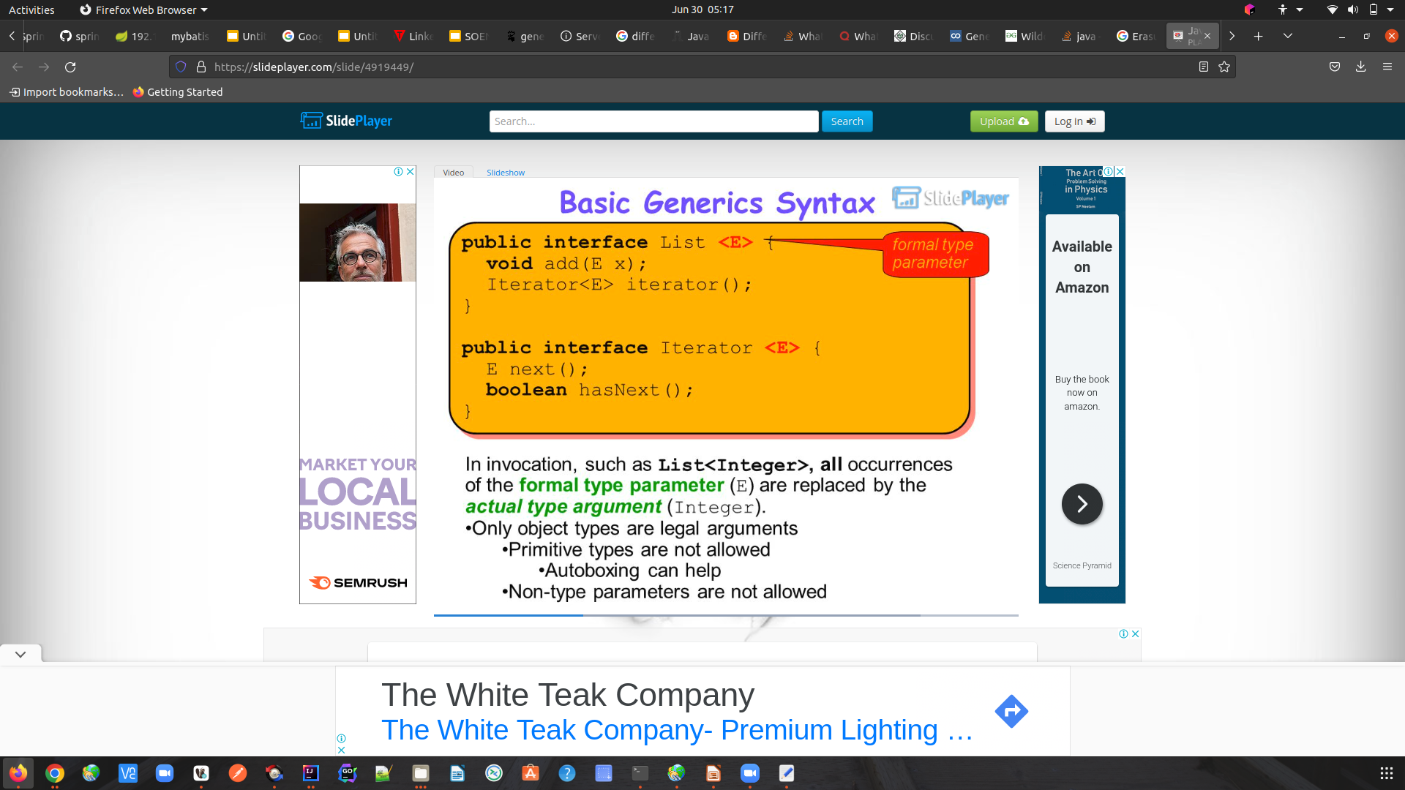

Slide 33
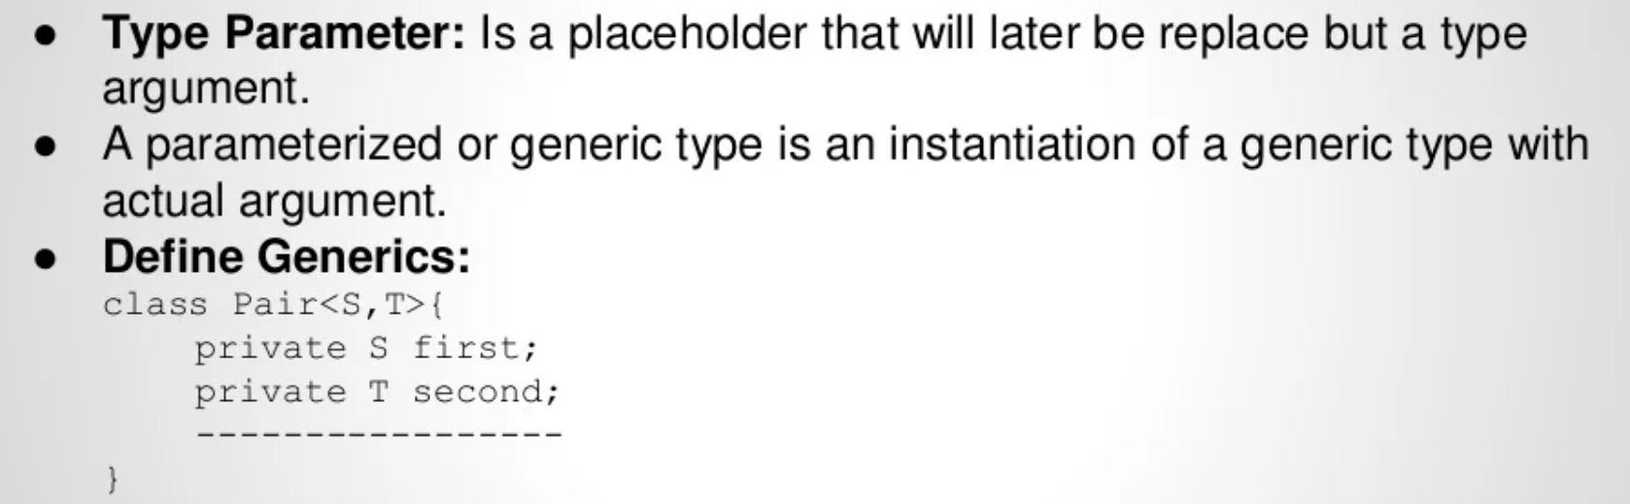
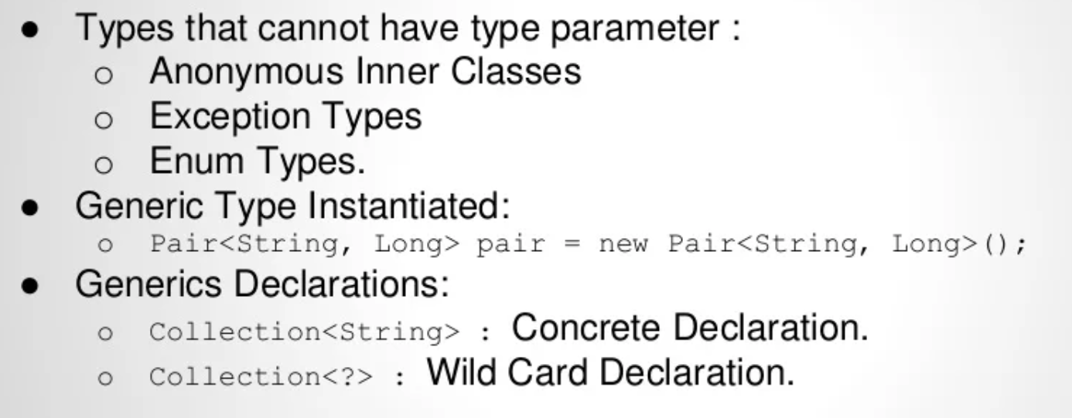
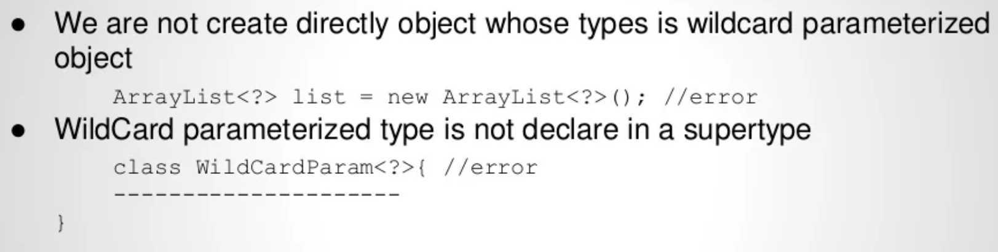
Generic Type
Wildcard in Generics

Slide 34
Generic classes: benefit
So, what is the difference between a generic class and a class defined using Object as the internal type? Consider a LinkedList class that can contain elements of type Object:
This seems interesting, until we get the elements from the list:
As the elements are of type Object, we must explicitly cast them to use them as objects of their own type after extraction.
Do you see any problem with that?
LinkedList list = new LinkedList();
list.add("abc"); // fine
list.add(new Date()); // fine as well
String s = (String)list.get(0); // cast required
Date d = (Date)list.get(1); // cast required

Slide 35
Generic classes: benefit
The problem is that the compiler cannot check at compile time whether such casts are valid or not. Upon execution, depending on what was actually stored as the elements of the list, the runtime system might throw a ClassCastException if the explicit casts are invalid.
Using generic classes, we can define such a LinkedList and parameterize it for every specific use and ensuring type safety for each different use of the generic class:
Thus, generic classes and the type erasure mechanism allow the programmer to:
Define classes that are valid in different contexts of use.
Ensure that they are used correctly in each specific context of use.
LinkedList<String> stringList = new LinkedList<String>();
stringList.add("Hello"); // fine
// list.add(new Date(1,1)); // error
String s = stringList.get(0); // no cast needed
LinkedList<Integer> integerList = new LinkedList<Integer>();
integerList.add(new Integer(10)); // fine
// integerList.add("Hello"); // error
Integer i = integerList.get(0); // no cast needed

Slide 36
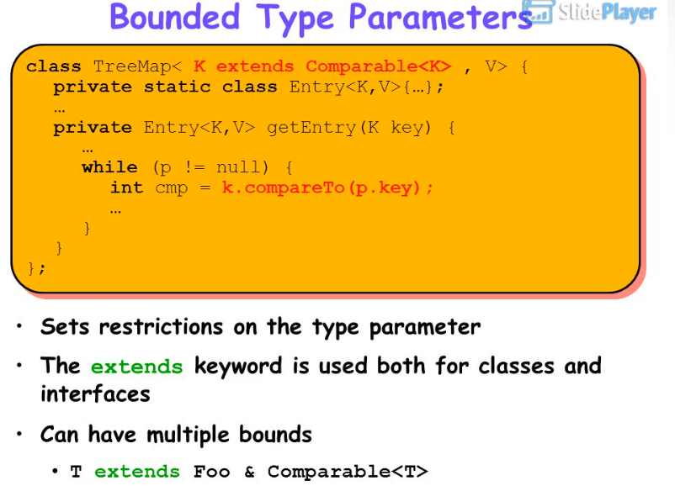
Generics: parameter type bounds
When defining a generic class/method, a type bound can be stated on any type parameter.
A type bound can be any reference type, i.e. a class type that is used to further describe a type parameter. It restricts the set of types that can be used as type arguments and gives access to the non-static methods of the type it mentions.
A type parameter can be unbounded. In this case any reference type can be used as type argument to replace the unbounded type parameter in an instantiation of a generic type.
Alternatively can have one or several bounds. In this case the type argument that replaces the bounded type parameter in an instantiation of a generic type must be a subtype of all bounds.

Slide 37
Generics: parameter type bounds
The syntax for specification of type parameter bounds is:
i.e. a list of bounds consists of one class and/or several interfaces.
The reason for imposing a type bound on a type parameter is that the code used in the implementation code of the generic class is assuming that the type used is of a certain type or any of its subtypes, or that it implements a certain interface.
This can lead to rather complex class declarations such as:
A pair class taking two parameters, where each parameter is of a certain type that implements Comparable with itself and implements Cloneable.
The class itself implements Comparable with itself and implements Cloneable, i.e. instances of this class are Comparable with each other and are Cloneable and the same is assumed of both parts of the Pair.
<TypeParameter extends AClass & AnInterface1 & ... & AnInterfaceN>
class Pair<A extends Comparable<A> & Cloneable ,
B extends Comparable<B> & Cloneable >
implements Comparable<Pair<A,B>>, Cloneable { ... }

Slide 38
Generics: parameter types, interesting cases
class PairUtil {
public static <A extends Number, B extends Number> double add(Pair<A, B> p) {
return p.getFirst().doubleValue() + p.getSecond().doubleValue();
}
public static <A, B> Pair<B, A> swap(Pair<A, B> p) {
A first = p.getFirst();
B second = p.getSecond();
return new Pair<B, A>(second, first);
}
}
In the add() method:
The method is generic over two type parameters A and B, which must be subclasses of Number, which allows to use doubleValue().
The argument to the method is a Pair; the type arguments to that Pair are constrained by the type parameter bounds to add().
In the swap() method:
The type parameters are used to define the return type, as well as the argument.
Local variables in the method are declared in terms of the type parameters.
The type parameters are used as type arguments in the constructor call.

Slide 39
Java generic class example: generic Pair class
public class Pair<TypeOfFirst, TypeOfSecond>{
private final TypeOfFirst first;
private final TypeOfSecond second;
public Pair(){}
public Pair(TypeOfFirst first, TypeOfSecond second){
this.first = first;
this.second = second;
}
public Pair(Pair<TypeOfFirst, TypeOfSecond> newPair){
this.first = newPair.getFirst();
this.second = newPair.getSecond();
}
public TypeOfFirst getFirst() {
return this.first;
}
public TypeOfSecond getSecond() {
return this.second;
}
public String toString(){
return first.getClass().getName() + ":" + first.toString() + " , "
+ second.getClass().getName() + ":" + second.toString();
}
}
public class PairDriver {
public static void main(String[] args) {
Pair<String, Integer> p1 = new Pair<String, Integer>("Hello", 1);
System.out.println(p1);
ArrayList<Integer> v1 = new ArrayList<Integer>();
for (int x = 1; x <= 3; x++)
v1.add(new Integer(x));
ArrayList<String> v2 = new ArrayList<String>();
v2.add(new String("un"));
v2.add(new String("deux"));
v2.add(new String("trois"));
ArrayList<Pair<Integer, String>> v3 = new ArrayList<Pair<Integer, String>>();
for (int x = 0; x <= 2; x++)
v3.add(new Pair<Integer, String>(v1.get(x), v2.get(x)));
for (Pair<Integer, String> p : v3)
System.out.println(p);
}
}
java.lang.String:Hello , java.lang.Integer:1
java.lang.Integer:1 , java.lang.String:un
java.lang.Integer:2 , java.lang.String:deux
java.lang.Integer:3 , java.lang.String:trois

Slide 40
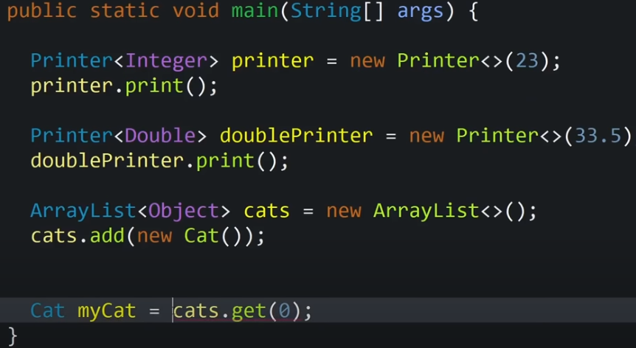
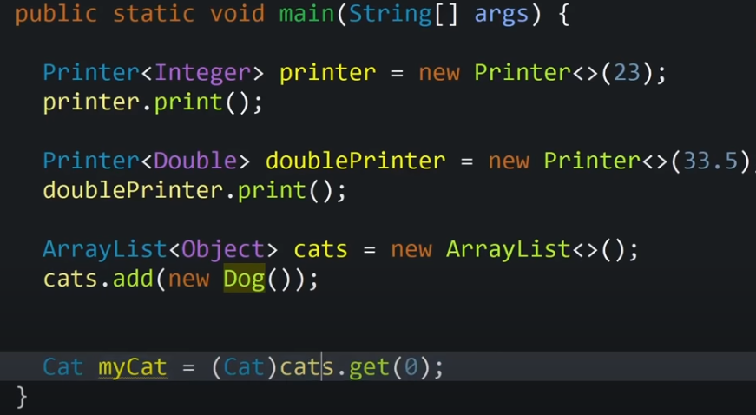
Having an array list that can hold any type of Objects causes all types of type safety issues.
Java Generics solves these kind of issues
Compilation Error
Compilation Error

Slide 41
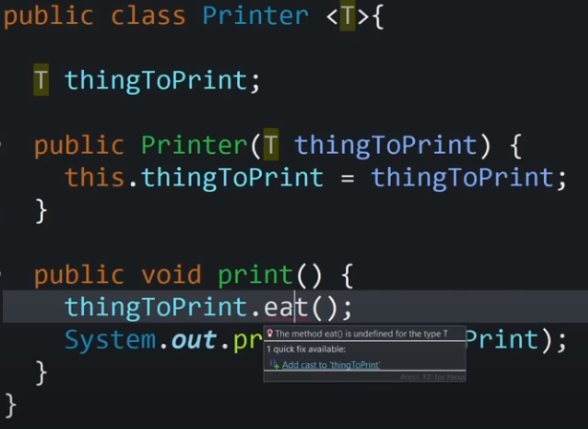
With generic type class we can use any object to print.
If we have to call eat method from the T, it may result in issues.

Slide 42
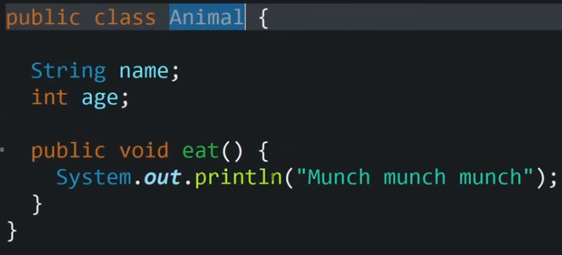
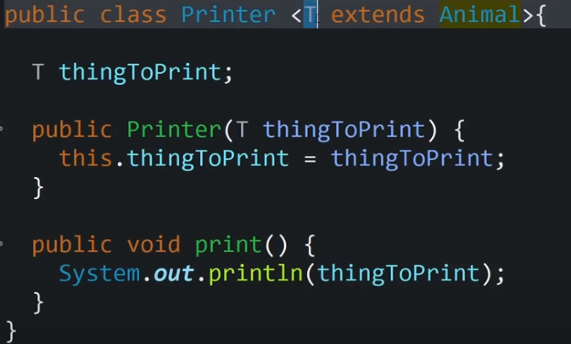



Bounded Generics
Bounded generic : provides certain bound limit on the type that are passed in
T is some type of an animal, since we know that thingToPrint is an animal in print method we can call eat() method.

Slide 43




Generic Methods

Slide 44


Slide 45

Wildcards
Object is the base class of Integer class
Does this work ?

Slide 46
Wildcards
A list integer is not a subclass of a list object
This is where wildcard comes into pic

Slide 47


Wildcards
Bounded Generic
Wildcard

Slide 48


Wildcards

Slide 49
References
Angelika Langer. Java Generics FAQ
Gilad Bracha. Generics in the Java Programming Language.
Paul Gibson. Generics (in Java)
David R. Musser, Alexander A. Stepanov. Generic Programming. In International Symposium on Symbolic and Algebraic Computation (ISSAC 1988). Lecture Notes in Computer Science 358, Springer-Verlag, 1989, pp 13-25.
Ronald Garcia, Jaakko Jarvi, Andrew Lumsdaine, Jeremy G. Siek, and Jeremiah Willcock. A Comparative Study of Language Support for Generic Programming. SIGPLAN Not. 38, 11 (October 2003), 115-134. doi=10.1145/949343.949317
Charles W. Krueger. Software reuse. ACM Comput. Surv. 24, 2 (June 1992), 131-183. doi=10.1145/130844.130856
Ross Tate, Alan Leung, Sorin Lerner. Taming Wildcards in Java’s Type System. Technical Report. Cornell University.
Joseph A. Goguen. Parameterized Programming. IEEE Trans. Softw. Eng. 10, 5 (September 1984), 528-543. doi=10.1109/TSE.1984.5010277
https://riptutorial.com/java/example/5954/deciding-between--t------super-t---and----extends-t-
http://www.angelikalanger.com/GenericsFAQ/FAQSections/TechnicalDetails.html
https://docs.google.com/presentation/d/1We8vNCA9uCIaSDnDM5fvTVdfrEfNvpM8AdSdPEzWl_Q/edit#slide=id.p21

Slide 51



Example (of a supertype with non-generic methods and a subtype with generic methods; not recommended):
Can a generic method override a non-generic one?
No.
This subclass compiles, but it does not show an example of overriding, but instead of overloading. This is because the supertype methods have the signatures set(Object) and get() , while the subtype methods have the signatures <$T1_extends_Number>set($T1_extends_Number) and <$T1_extends_Number>get() . In this example, not even the erasures of the signatures are identical, so that there is not the slightest chance that the subtype methods could override the supertype methods. Instead, the subtype methods overload the supertype methods. What happens when we invoke the overloaded methods?
Although the erasures of the subtype methods have signatures that are identical to the supertype methods' signatures the respective signatures are not override-equivalent. The override-equivalence only holds when the subtype method's signature is identical to the erasure of the supertype method's signature, but not vice versa.
Consequently, the subtype methods overload, instead of override, the supertype methods. Moreover, the fact that the erasures of corresponding methods in super- and subtype are identical is in conflict with the rule that a class (the subclass in this case) must not have methods with identical erasures. As a result the compiler issues error messages.

Slide 52

Can a non-generic method override a generic one?
Yes.
Here the subtype methods have signatures, namely set(Object) and get() , that are identical to the erasures of the supertype methods. These type-erased signatures are considered override-equivalent.

Slide 53



